Slide 1
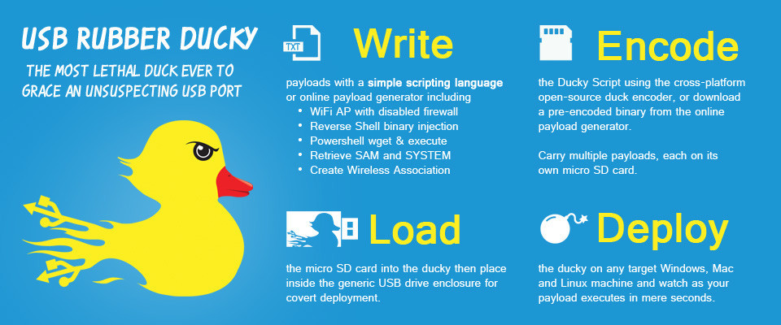
Rubber Ducky Intermediate Labs
Send an Email via Gmail

Slide 2
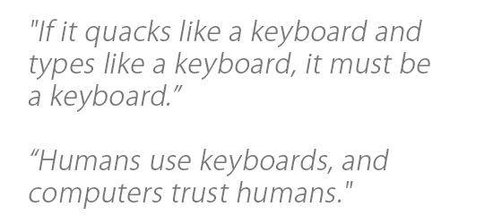
Required Materials
1 Windows PC (Windows 7 or newer)
Internet Access
USB Rubber Ducky (can be obtained from staff)
MicroSD to USB reader (can be obtained from staff)
WARNING! DO NOT plug in Rubber Ducky directly to your machine. First check the MicroSD card using card reader, ‘right click’ on drive and select ‘quick format’, then click ‘start.’ You do not know who was using this device before you, or what payload may remain.
ENJOY USING THE RUBBER DUCKY
Estimated Time to Complete: 45 min

Slide 3
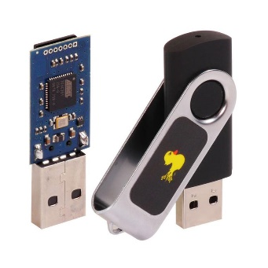
What is Rubber Ducky?
The USB Rubber Ducky is a powerful keystroke injection tool that can be disguised as an ordinary flash drive. Computers recognize it as a keyboard and accept pre-programmed keystroke payloads at over 1000 keystrokes per minute.
Payloads can be created using a simple scripting language that issues one command per line. For example, one command is ‘TAB’ which mimics using the TAB key, or another example of a command is ‘STRING hello world!’, which types/prints “hello world!” The full list of Windows commands and descriptions can be found here: https://github.com/hak5darren/USB-Rubber-Ducky/wiki/Duckyscript
Every computer (Desktop, Laptops, Tablets & Smartphones) takes inputs from the keyboard. Because the computer views the Rubber Ducky device as an input device (i.e., Keyboard). The program code that is resident in a file stored in the Rubber Ducky is treated as input to the compiler. This is why the Rubber Ducky USB device, which works as a Human Interface Device (HID) is automatically detected by most modern operating systems. By taking the advantage of this, one can penetrate the computer.

Slide 4
Ethics – Doing the Right Thing
The information and skills learned and taught in this lab can be used maliciously.
Never forget that cyber attacks/hacks no matter the intent are a serious crime, if convicted you can go to Federal prison!
(ISC)2 Code of ethics
-Protect society, the commonwealth, and the infrastructure.
-Act honorably, honestly, justly, responsibly, and legally.
-Provide diligent and competent service to principals.
-Advance and protect the profession.

Slide 5
Send an Email via Gmail
In this lab we will learn how to use rubber ducky to automate some basic CLI (command line interface) commands. We will open a browser and login into Gmail, then we will compose a mail and send it to desired address. We will use notepad as our word processor, but you can use any other.
We need to first create a script for this ‘Send an Email via Gmail lab’ using https://ducktoolkit.com/encoder/ and type in the script where it says “STRING Enter Ducky Script Here”.

Slide 6
Send an Email via Gmail
The Rubber Ducky is a keyboard emulator that will automatically run pre-generated scripts.
This can come in handy when using Windows CLI (command line interface) OR PowerShell.
In this lab we will show you a ducky script that will compose a mail and send that mail to desired address using Gmail.
You can try a different Email services like Yahoo, Hotmail, Outlook, etc.
In order to have full understanding, you should understand the concepts of using the command prompt in Windows. (See “Command line intro” lab in the “1. Intro Labs” folder
On the next slide we will explain the sample code line-by-line

Slide 7
Send an Email via Gmail
Send E-mail via Gmail
Windows Payload
COMMAND EXPLANATION
1. DELAY 1000 <Delays 1000 milliseconds>
2. GUI r <opens ‘run’>
3. DELAY 500 <Delays 500 milliseconds>
4. STRING www.gmail.com <types ‘link to Gmail’>
5. ENTER <opens gmail.com>
6. DELAY 2000 <Delays 2000 milliseconds>
7. STRING secguy007”gmail.com <types ‘username’>
8. ENTER <opens password window>
9. DELAY 1000 <Delays 1000 milliseconds>
10. STRING PaceLab101 <types ‘password’>
11. ENTER <login to account>
12. DELAY 3000 <Delays 3000 milliseconds>
13. TAB <mimics TAB key>
14. REPLAY 10 <repeat TAB for 10 times>
15. ENTER <opens ‘Message textbox window’>
COMMAND EXPLANATION
16. DELAY 500 <Delays 500 milliseconds>
17. STRING XYZ@example.com <types ‘To’ email address>
18. DELAY 50 <Delays 50 milliseconds>
19. TAB <mimics TAB key>
20. DELAY 50 <Delays 50 milliseconds>
21. TAB <mimics TAB key>
22. STRING HI <types ‘Subject’ line>
23. DELAY 50 <Delays 50 milliseconds>
24. TAB <mimics TAB key>
25. STRING You just got QUACKED!! <(.) <types ‘Message’/’content’>
26. DELAY 50 <Delays 50 milliseconds>
27. TAB <mimics TAB key>
28. ENTER <Send the message>
29. DELAY 500 <Delays 500 milliseconds>
30. CTRL W <Close the web browser>

Slide 8
Implementation
Once you're ready with the script you will need to convert that into a .bin (binary) file
For this conversion you can either use following link or you can download encoder for rubber ducky.
url: https://ducktoolkit.com/encoder/
In order to generate the payload click on ‘generate payload’ on the right side of the screen, then click on the file called inject.bin, which will initiate the download

Slide 9
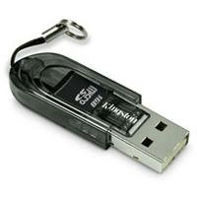
Implementation Continued
When you have the ‘inject.bin’ file downloaded, we need to transfer the file into microSD card using the microSD to USB card reader. (See below)
Once, finished, insert the microSD card into the rubber ducky and connect the ducky to the target machine
The script will automatically run and once you connect the ducky it will send an Email via Gmail within 8-9 seconds.

Slide 10
Improve the code on your own
What if we wanted to use another browser?
Instead of closing the web browser, how can we logout from the account?
Remember, we can only use the keyboard.

Slide 11
What’s next?
Can you think of how to create a script when you can’t use the mouse?
Every Ducky script must be created with this principle in mind.
Make sure that you are thinking about every single keystroke.

